Slide 1
AI Project Update
12/30

Slide 2
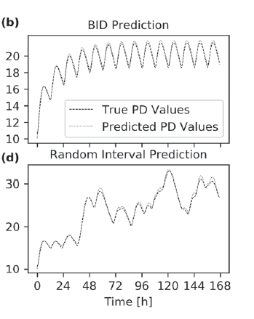
Background - Liu’s PK/PD
Major result
LSTM was able to model rich data (0.5 hr interval, QD, BID, or TID for 1 week) in PK/PD of indirect response model (II)
Limitations
LSTM and/or the methodology was not able to model the sparse data (as claimed)
Was not able to extrapolate to doses outside of training

Slide 3
Objectives
Develop new methodologies (different AI algorithms and neural network structures) that are able to:
Model sparse data
Extrapolate to outside of training doses
Explore a different structural PK/PD model
Liu’s IDR II: PD from 100% to infinity
Current IDR I: PD from 100% to 0% (potentially more challenging)

Slide 4
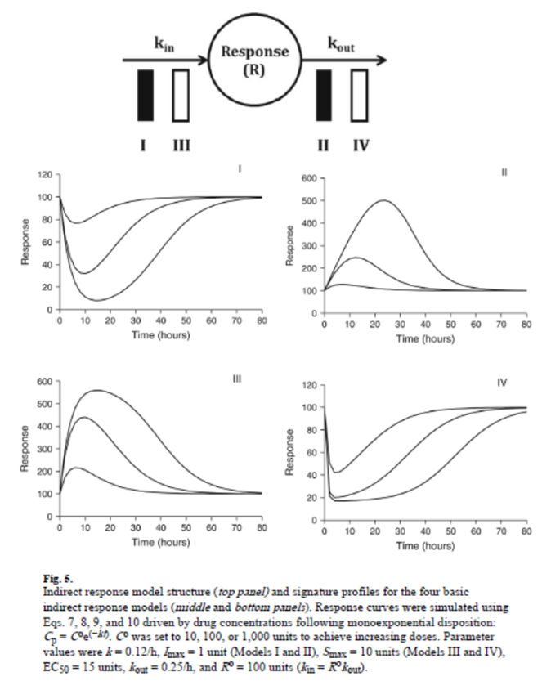
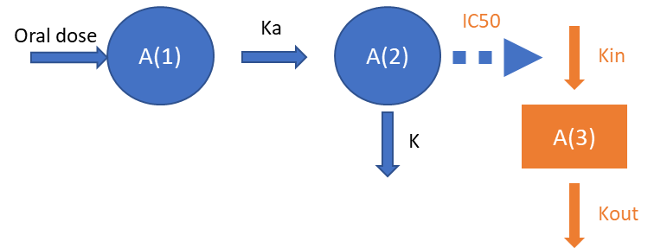
Methods
PK/PD
IDR (I)
PK model: Interindividual variability of volume at 20% CV
PD model: Proportional residual error at 20% CV
Evaluated various combinations of PK/PD parameters
AI
Different algorithms (including GRU comparison)
Different structural layers of neurons
Incorporation of additional variables (such as Time, Dose)

Slide 5
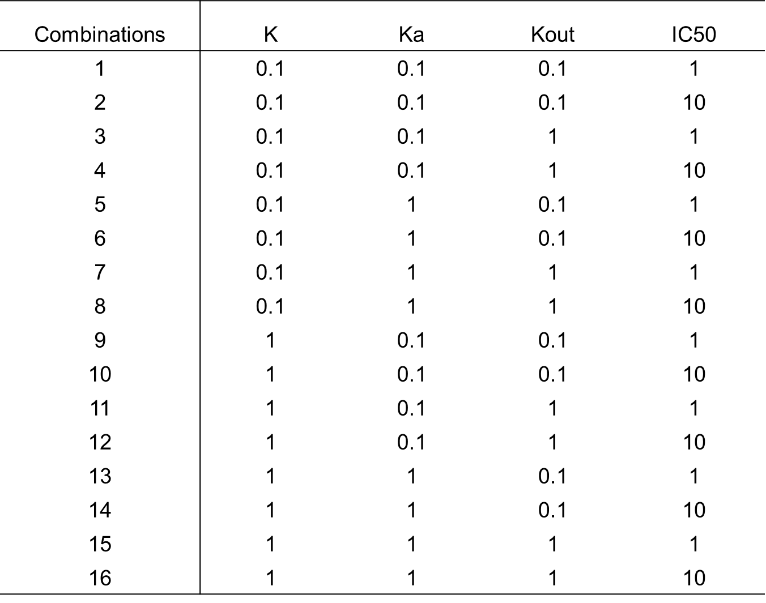
Focus on Comb (6)
Obvious PK/PD hysteresis (Kout = 0.1 1/hr)
Doses: 0.03, 0.1, 0.3, 1, 3, 10, 30 mg
IC50 = 10 (less potent), so as to cover a wide range of PD response
Simulation N=100 for each dose
PK time: 4 hr interval (5 time/day)

Slide 6
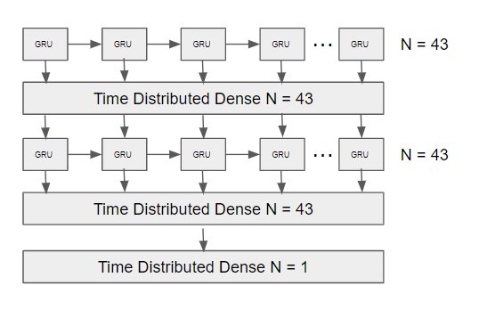
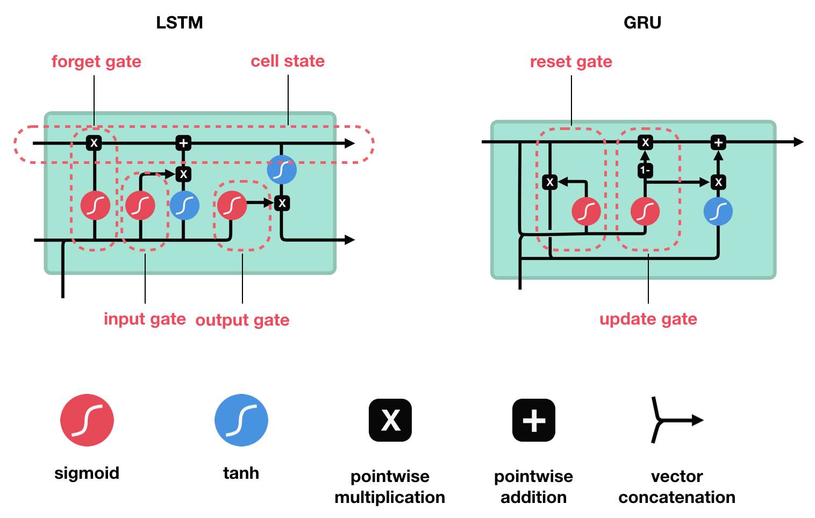
AI Methods
Evaluate both LSTM to GRU
Training 90%, testing 10%
LSTM has a separate memory gate while GRU mixes the hidden state with the memory. Theory: mixing the hidden state with the memory is better because the input data will not tell the LSTM when to forget the memory (delayed response), on the other hand the update gate on the GRU will forget over time when new data was introduced.

Slide 7
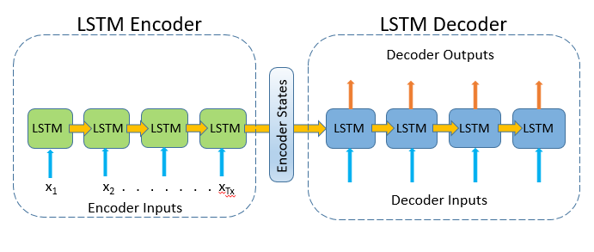
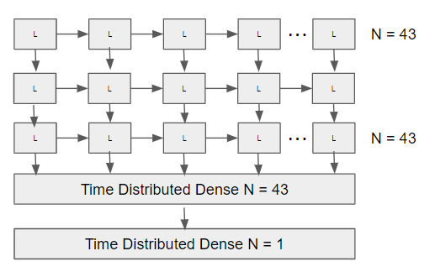
Attempted Methods

Slide 8
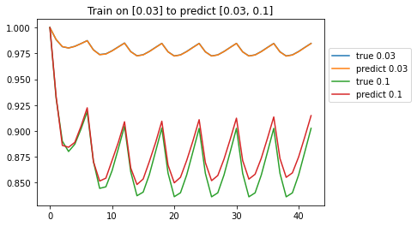
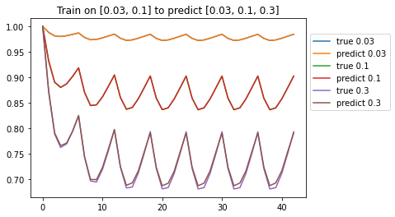
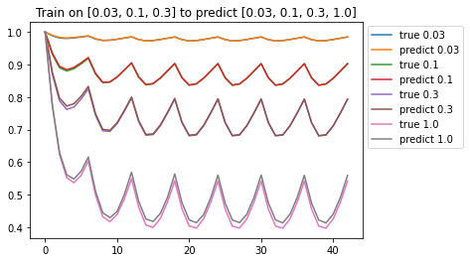
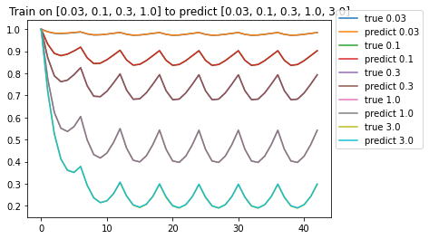
Results: Training on low doses and predictions for high doses (1)
Predictive for doses 3-10 fold higher, but not higher

Slide 9
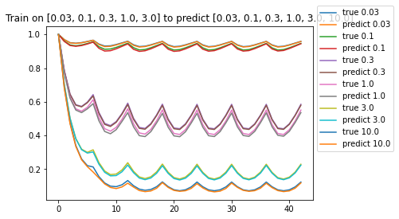
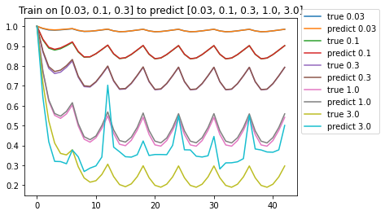
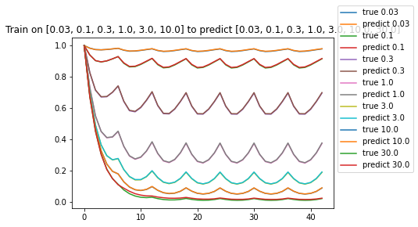
Results: Training on low doses and predictions for high doses (2)
Predictive for doses 3-10 fold higher, but not higher

Slide 10
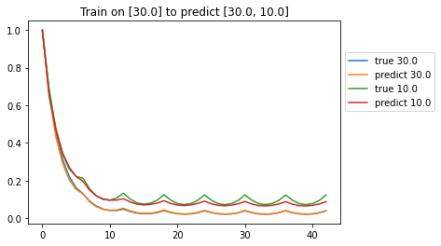
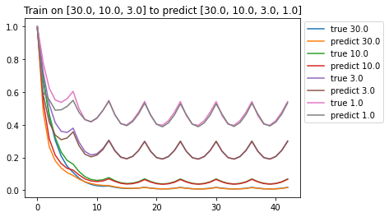
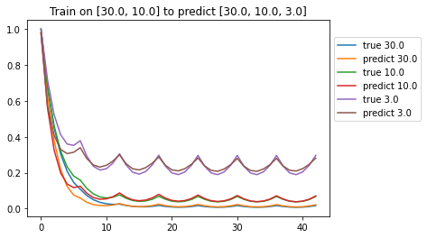
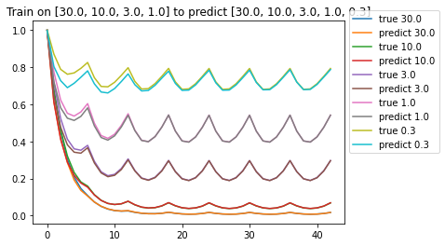
Results: Training on high doses and predictions for low doses
Predictive for doses 3-10 fold lower, but not lower

Slide 11
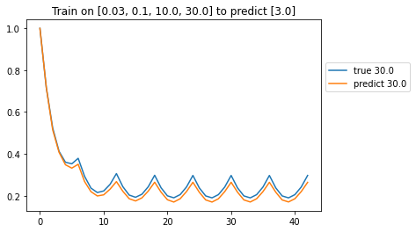
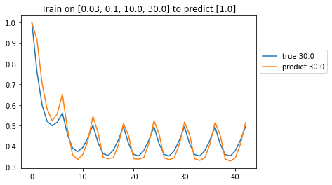
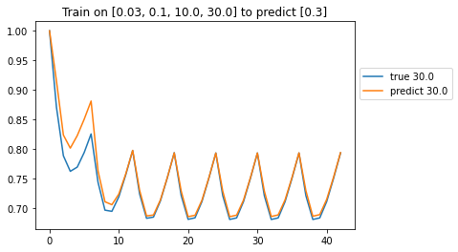
Results: Training on high and low doses and predictions for mid doses

Slide 12
Ongoing works
QD to BID - inside and outside of dose range
Sparse sampling but with more practical PK time interval is different (more practical, 0.5, 1, 2, 4, 8, 24)

